Slide 1
Components vs. Objects

Slide 2

GameObject
Dynamic
Static
Player
Monster
Tree
Evil Tree
Notes:
The way we start writing a game system is typically to come up with a quite complicated object hierarchy – this makes sense as it’s what we’re used to, it’s how we got taught to write code (most of the time). So we might have an object hierarchy that looks like this:
But what if we want an entity that is both a tree and a monster?
We inherit from both Monster and Tree, but they both ultimately inherit from GameObject… This is the “Deadly Diamond of Death”. We can fix it with virtual inheritance, but that has a performance impact and odds are we’re going to run into more situations where this is a problem, so we need to consider a better approach to the solution.

Slide 3
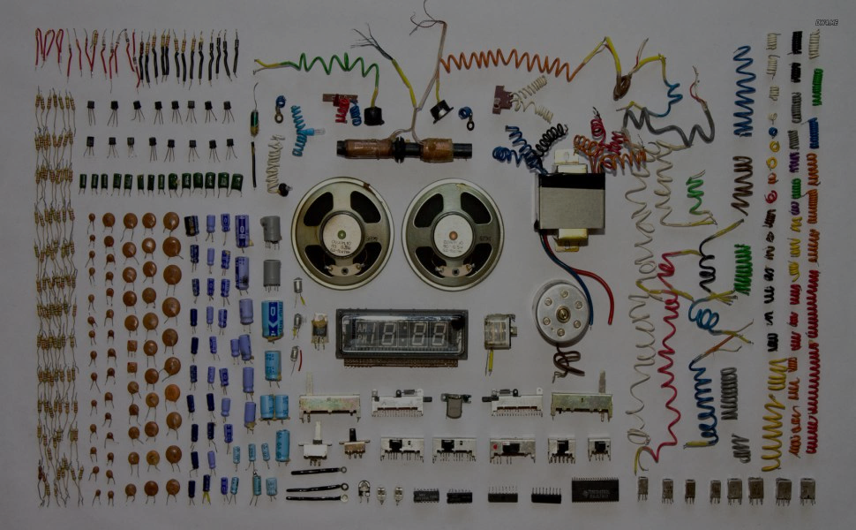
Tree
Evil Tree
Roaming Evil Tree
Position
Target Seek
Sprite
Combat
Notes:
The most common way of solving this is to avoid inheritance as much as possible and instead build our entities through composition – so an entity becomes an aggregation of components that dictate it’s behaviours.
Ideally, a component should only contain some data – without any functionality. But we can reach a half way house, which is what Unity does (hence “Add Component”!)
In that case, we could have a handful of components, such as these:
Position, Target Seek, Sprite, Combat (though takes these with something of a pinch of salt)
And depending on how we plug these in, we can get different objects that behave in completely different ways from each other!

Slide 4
Component
Entity
System
Notes:
This approach makes it much easier to add new entities, which we can build into something that is incredibly complex. It also allows us to define entities in data without much hassle and it works out to be more efficient. (which is nice).
The “pure” approach is to ensure that our components contain no methods and are represented by pure data. In such a system we have three parts – components, entities and systems – hence it being called a component entity system…
So a component describes a certain aspect of an entity and its parameters – by themselves, components are meaningless.

Slide 5
Component
Entity
System
Notes:
An entity is something that exists in the world, it’s actually little more than a list of components (in most implementations, they’re actually nothing more than a unique id – so we don’t even need a distinct entity class. All we do is tag any component that makes up the entity is tagged with the ID of the entity they are associated with. We can easily add or remove components to an entity, allowing us to mutate their behaviour on the fly. So we could have a spell that gives the velocity component to an otherwise static object it is case upon to make it move (or we could freeze an entity by removing the velocity component).

Slide 6

Notes:
But wait, so far, we’ve described components as having nothing but data attached to them and entities are just unique id values – so where does any logic go?
The answer lies in the “System” part of our approach. A system operates on sets of components; so the movement system only handles entities that have position and movement components added to them.
This way, we’re shifting all of our game logic code out of the individual entities and into our systems, which lets us add a whole lot of interesting behaviours that just need specific combinations of components added to an entity to be used.

Slide 7
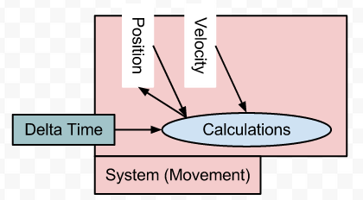
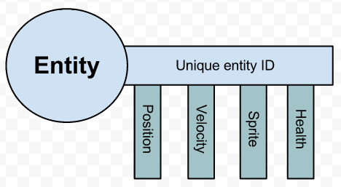
Notes:
One of the best ways of thinking about this is a key and lock system: a key is the entity, with a series of attached components. Each system then acts as a lock – it will only work when the right “teeth” are present. We can represent which components are attached to an entity using a bit for each component type, a long integer type would give us scope for representing around 32 components (a long long would give us 64)…
We can represent the “teeth” using a bitwise binary setup. So this key has a value of 1111, while the first lock is looking for 11– (it only cares about position and velocity, nothing else), we can do a straight bitwise and to check: ((1111 & 1100) == 1100)

Slide 8
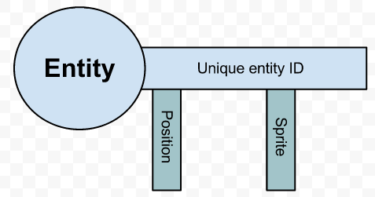
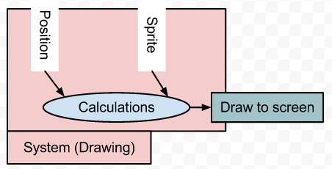
Notes:
Similarly, the second “lock” is looking for 1-1-, so our first lock matches as it has both those components attached. But what about a different key? This key represents an object that just has a position and a sprite, so it’s basically a static prop – it doesn’t fit the movement lock, but it does fit the drawing lock.
Systems themselves don’t store any data, they just work with what they’re given by the components – they process all the entities that match their requirements, then the next system goes and the next and so on.

Slide 9
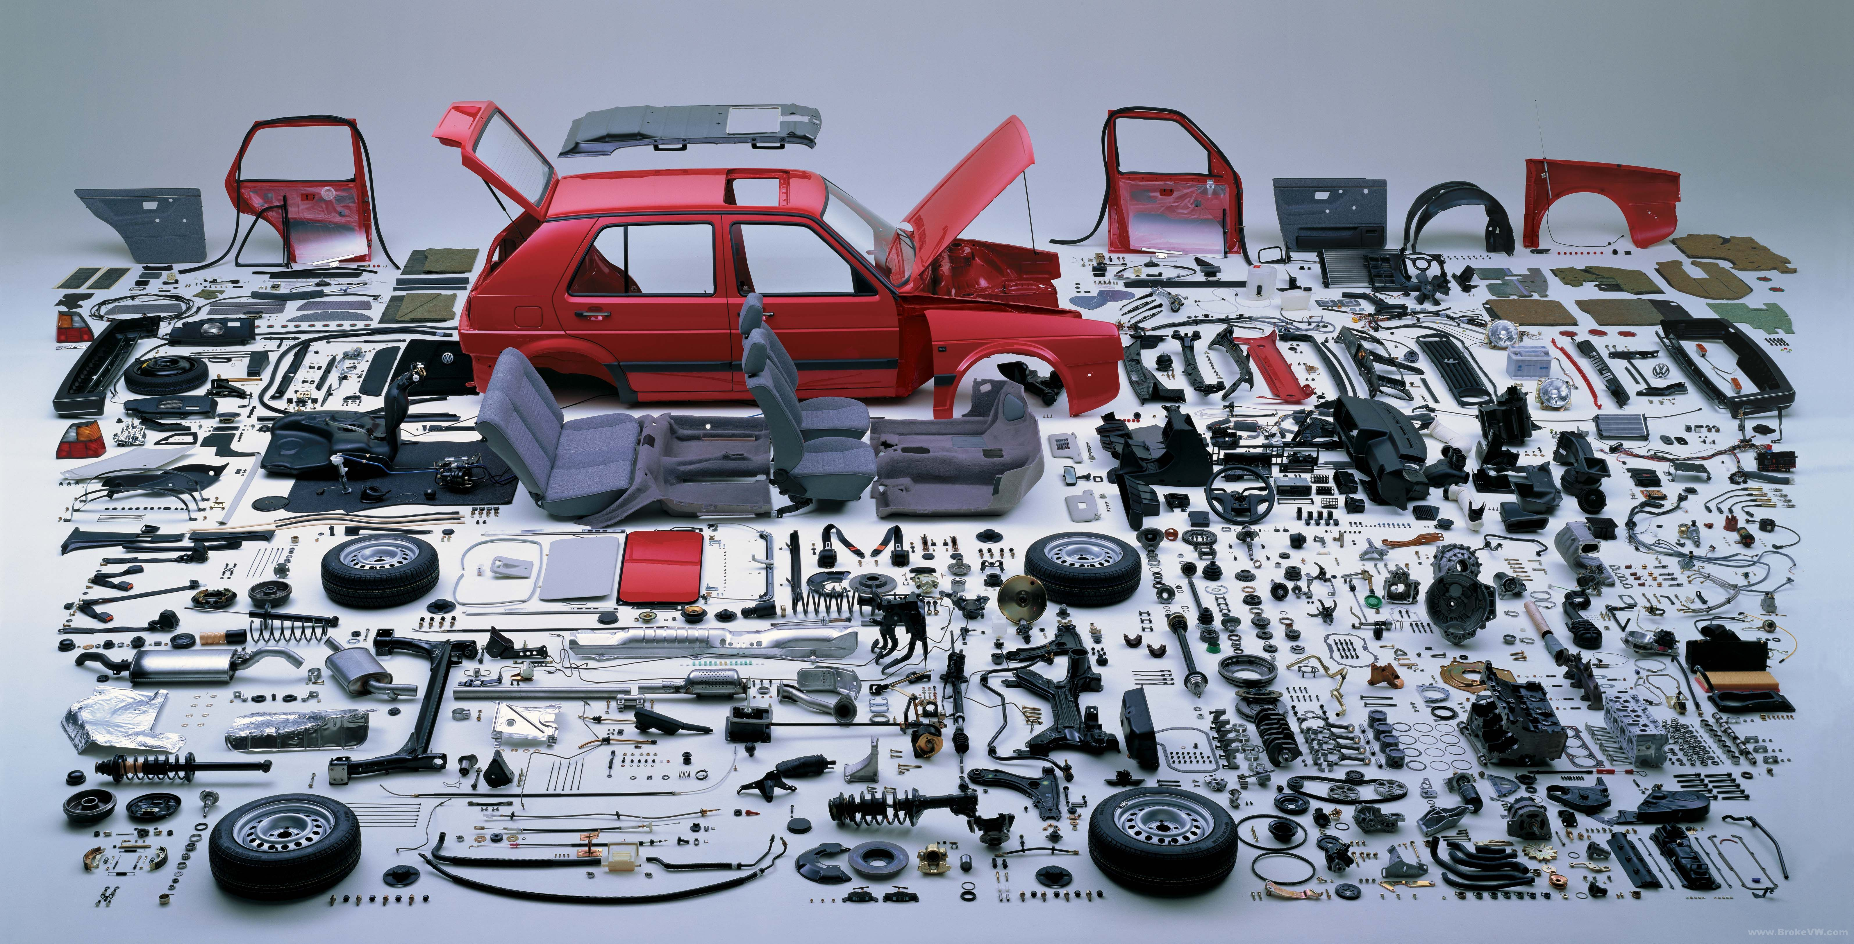
Data, not code
Atomic sets of data
Data is never shared
Notes:
So how do we decide what components we need for our game?
When designing components, we should consider a few rules of thumb:
Components are data, not code – game state, not functionality
Components are as small as possible – they’re atomic - so the smallest set of data possible for a particular aspect of the entity
Components never share data – if data should be in two components, create a third component for it!
Let us consider the fabled bomberman…

Slide 10
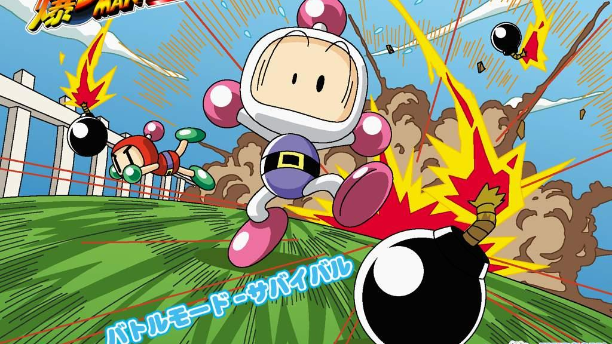
Move the player up/down/left/right
Drop a bomb
Detonate a remote bomb
Kick a bomb
Jump one space
Teleport a player
Kill a player
Upgrade a players future bombs
Dissolve a block
Spread / block the explosion
Position of each player in pixels
Cell that the player is standing in
Bombs in play
Fuse left on each bomb
Tiles covered by bomb explosion
Tiles affected by bomb explosion
Tiles that block bomb explosion
Scores for each player
Positions of all solid blocks
Positions of all soft blocks
Positions of all powerups
Position of all special features.
Notes:
Bomberman is pretty straight forward as games go – but that makes it pretty ideal for figuring out a nice list of useable components, note that we’re not going to look at any programming issues here, just straight up design logic!
This process is pretty iterative and we start by listing out all the behaviours and the data…
Note that some of these will vary between versions of bomberman, so we’re going for something a bit generic.

Slide 11
CellPosition
x (int), y (int)
Position of each player in pixels
xpixel(int)
ypixel(int)
Cell that the player is standing in
xcell(int)
ycell(int)
Bombs in play
xcell(int)
ycell(int)
Fuse left on each bomb
secondsLeft(float)
Scores for each player
kills(int)
deaths(int)
ScreenPosition
x (int), y (int)
TimedEffect
timeRemaining (float),
effectType (enum)
Explosion distance(int), affectSolids(Boolean), affectsSofts(Boolean), affectsPlayers(Boolean), penetratesSolids(Boolean), penetratesSofts(Boolean),
penetratesPlayers(Boolean),
damage(int)
Notes:
From there, we can start to think about how we can represent the data in terms of data types and structures, we want to try and ensure that we use the basic types: int, float, enum, Boolean and string (we may also throw in lists and maps, but they tend to end up being quite complicated games).
We can start to see some patterns emerging from this, but we need to give some consideration to whether things like our various uses of “xcell” and “ycell” are identical to each other or if they mean something slightly different (or worse, might mean something in the future) – if they don’t, great, they can be one component, if they might change? They should be two separate components.
So from that set of data types, we might start constructing a series of components that look a bit like this:
But we’re instantly bashing into a problem – remember the second rule of components? They should be small as possible – explosion is HUGE!

Slide 12
Spreadable
depth(int)
spreadPattern(enum)
Score
kills(int),
deaths(int)
Teleport
cellsDeltaX(int), cellsDeltaY(int)
Damager
inflictedDamage(int)
Destroyable
hitPoints(int)
PowerupPlayer addsFeature(enum), amount(int)
CellPosition
x (int), y (int)
Collideable
height(int)
ScreenPosition
x (int), y (int)
BombLayer
spread(int), depth(int), damage(int)
TimedEffect
timeRemaining (float),
effectType (enum)
Notes:
With a bit more time, we can figure out an even neater approach that gives us a lot more flexibility in the sorts of entities we can construct but while also giving us all the properties we require to produce a classic game of bomberman.
Spreadable has a depth value that decreases with each square it spread, it runs out at 0 – this lets us link this to the concept of “height” in collideable to handle all the previous elements we had in explosion.
TimedEffect has an enum that says whether the effect spreads or if it vanishes after the time runs out
Collideable – if height > spreadable depth, we flow around instead of over.
BombLayer – nothing to do with a rendering layer for bombs, instead attached to anything that can drop a bomb (player, AI, pickup…)

Slide 13
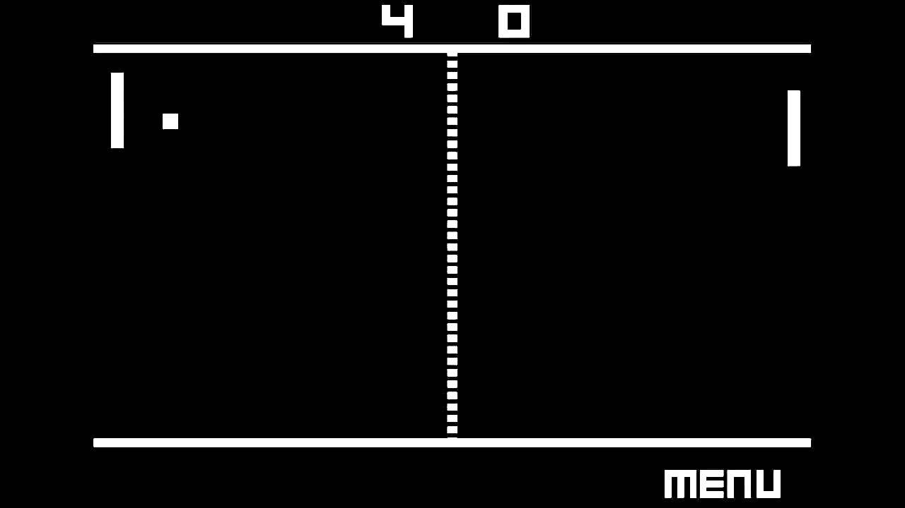
Notes:
Let’s consider ourselves some good old pong action…
What are the components we might need?
Player Controllable: y target (float)
AI Controllable: y target (float)
Sprite: sprite (texture)
Position: x (int), y (int)
Velocity: x (float), y (float)
Circle Collider: radius (float)
Box Collider: x min (float), x max (float), y min (float), y max (float)
Score: wins (int)

Slide 14
Paddle
Player Controllable
Position
Sprite
Box Collider
Score
Ball
Velocity
Position
Sprite
Circle Collider
Notes:
A paddle entity would be constructed like this:

Slide 15
Rendering
Collision
Input
AI
Movement
Score
Notes:
Rendering – renders all entities sprite components “sprites” at their position components x and y coordinates.
Collision – Checks for collisions between all entities which have a position component and either a box or circle collider.
Input System – Processes user input for any entites that have a player controllable component, setting the y target position ready for the movement system to make use of.
AI System – Runs some basic prediction logic for entities with the AI Controllable component and assigns a y target position.
Movement – Updates positions for entities with a position component and a player controllable or an AI controllable or a velocity component by interpolating the entities position to the target position.
Score – Displays the current score for each entity with a score component (we could have another component that specifies where this is located – so a score position maybe.)

Slide 16

Notes:
This approach is typically referred to as a data driven design, it means that we could drive a whole lot of ours systems by specifying entity structures in an editor (or script file), making it really easy for designers to work with as they don’t need to get programmers involved to create new objects (unless they need a specific behaviour / component which would need a programmer to produce extra code to write the system…)
We can load the configuration file and work through the elements for each entity it describes, we start by generating a unique id (which could be as straightforward as just incrementing a counter) and we can then use that id to index into lists of component types. So in effect, we have an array (or list or map) of every component, so whenever we want to process an entity, we can use it’s id value to index into the component arrays.

Slide 17
#define MOVEMENT_MASK (COMPONENT_DISPLACEMENT | COMPONENT_VELOCITY)
void movementFunction(World *world)
{
unsigned int entity;
Displacement *d;
Velocity *v;
for (entity = 0; entity < ENTITY_COUNT; ++entity)
{
if ((world->mask[entity] & MOVEMENT_MASK) == MOVEMENT_MASK)
{
d = &(world->displacement[entity]);
v = &(world->velocity[entity]);
v->y -= 0.98f;
d->x += v->x;
d->y += v->y;
}
}
}
unsigned int createTree(World *world, float x, float y)
{
unsigned int entity = createEntity(world);
world->mask[entity] = COMPONENT_DISPLACEMENT | COMPONENT_APPEARANCE;
world->displacement[entity].x = x;
world->displacement[entity].y = y;
world->appearance[entity].name = "Tree";
return(entity);
}
typedef struct
{
int mask[ENTITY_COUNT];
Displacement displacement[ENTITY_COUNT];
Velocity velocity[ENTITY_COUNT];
Appearance appearance[ENTITY_COUNT];
} World;
Notes:
So we end up with something that looks like this – entity_count is the maximum number of entities we can have in the world at any time. We then have an array of ints that form our bitmasks to say which components an entity has attached. After that, we have all arrays of each of our components (of course, this is an example of the total). We start by setting all of the mask values to 0 (or COMPONENT_NONE) – which we can use to look for an “empty” entity slot.
So if we want to create a tree, it looks like this: createEntity just returns the first un-used index value (so the first entry in the mask array that is set to COMPONENT_NONE).
Finally, our systems can look like this: simple function calls that loop through the entity list and check if they meet certain component requirements – if they do, they do their work and move on.

